Slide 1
Digital System Design CE 325 L1 SPRING 2024
Instructor : Dr. Syed Arsalan Jawed
Associate Professor of Practice
arsalan.jawed@sse.habib.edu.pk
Room : W-301
Office Hours : Monday 0930-1030, Wednesday 1430-1530, Friday 0930-1030

Slide 2
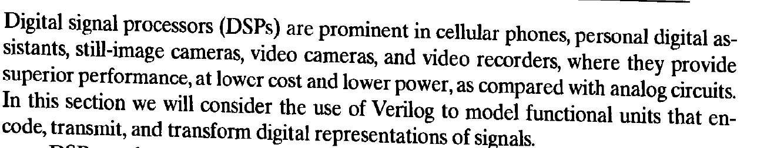
Algorithms and Architectures for Digital Processors, Chapter 9
Digital Filters and Signal Processors

Slide 3
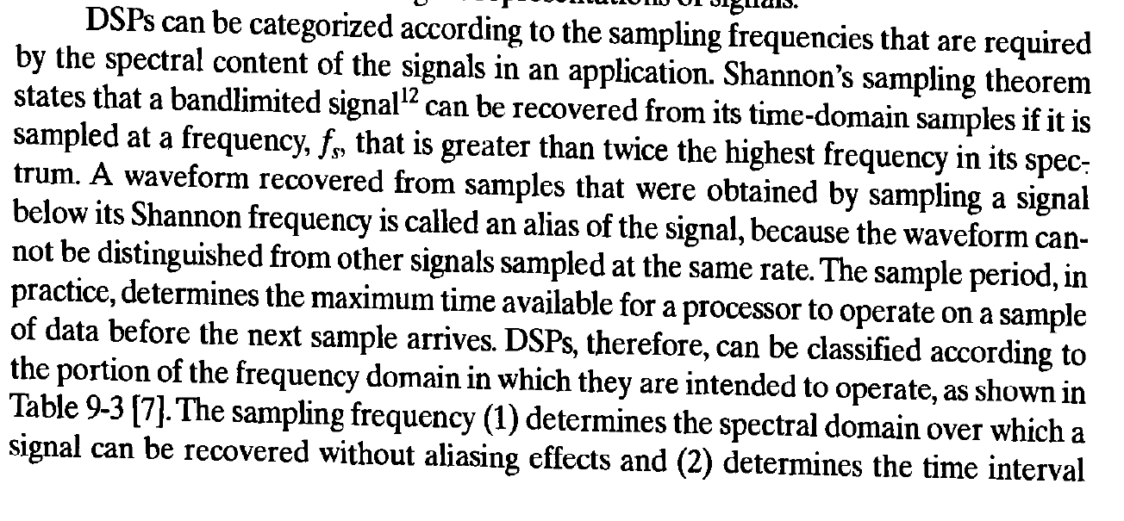

Slide 4
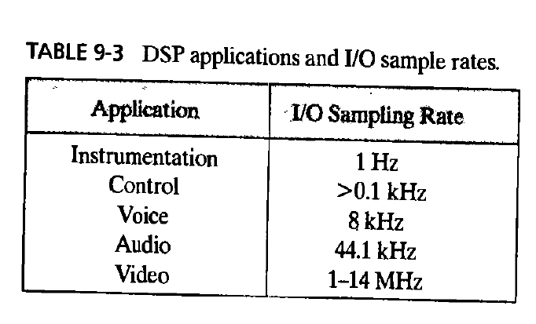

Slide 5
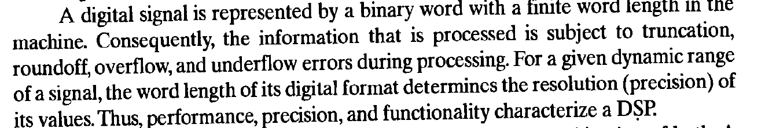

Slide 6
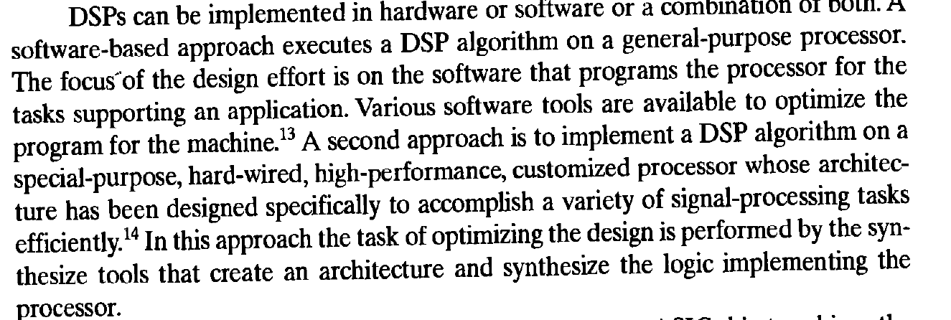
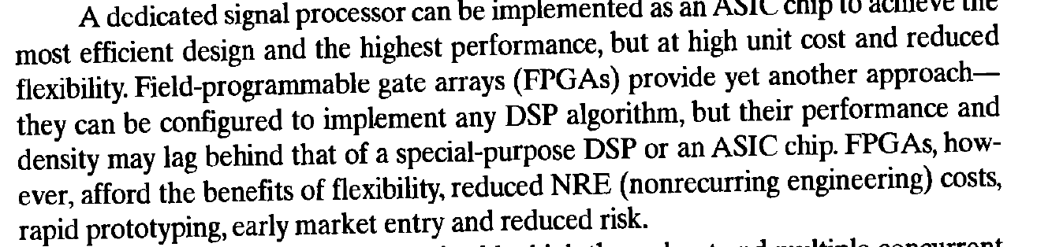

Slide 7
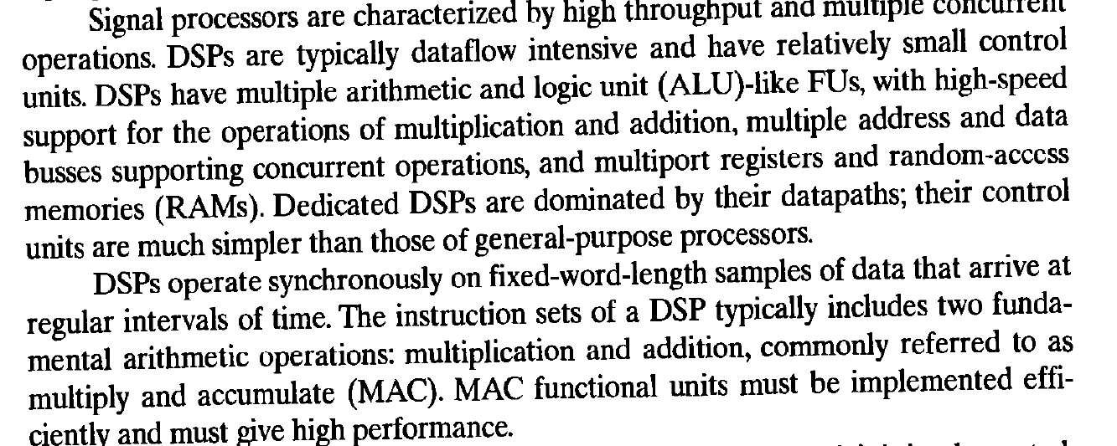

Slide 8
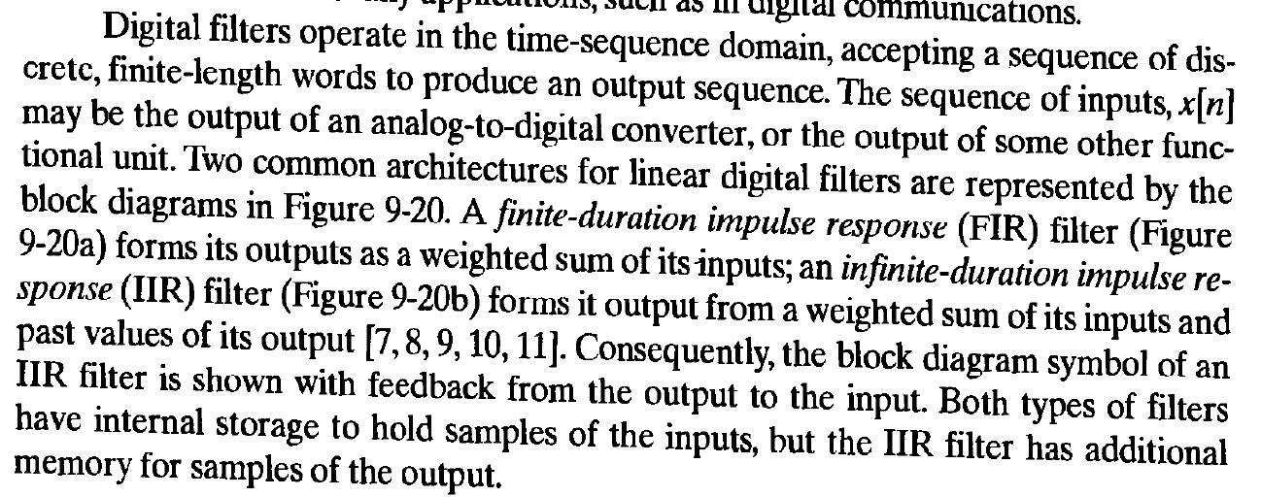
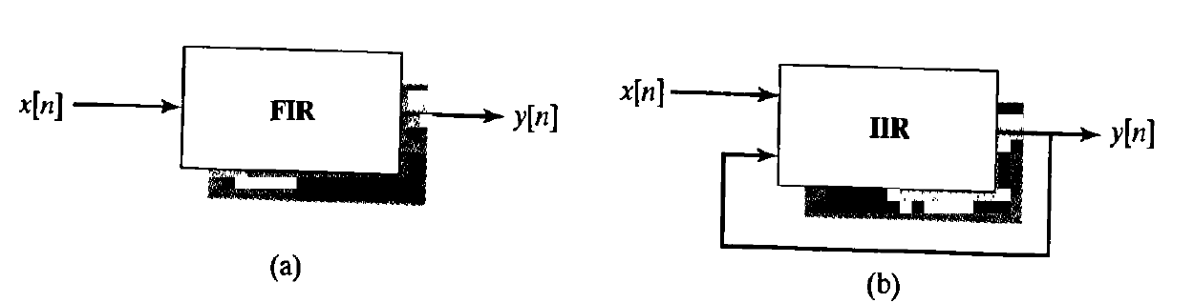

Slide 9
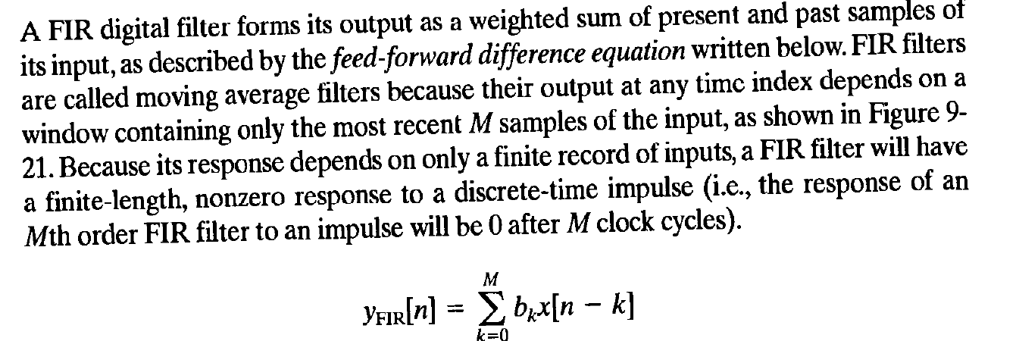
FIR Filter

Slide 10
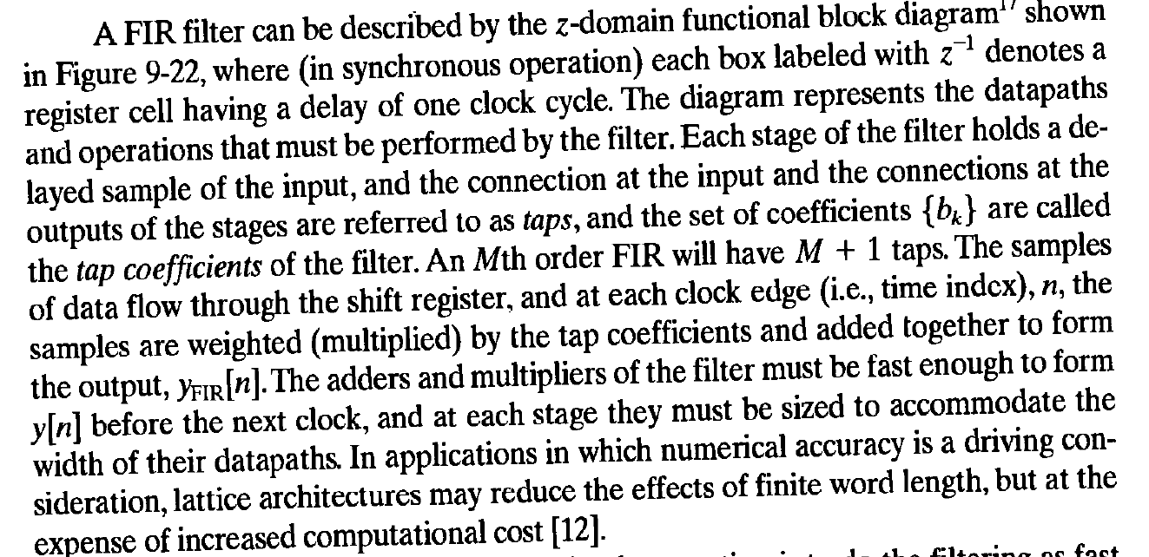

Slide 11
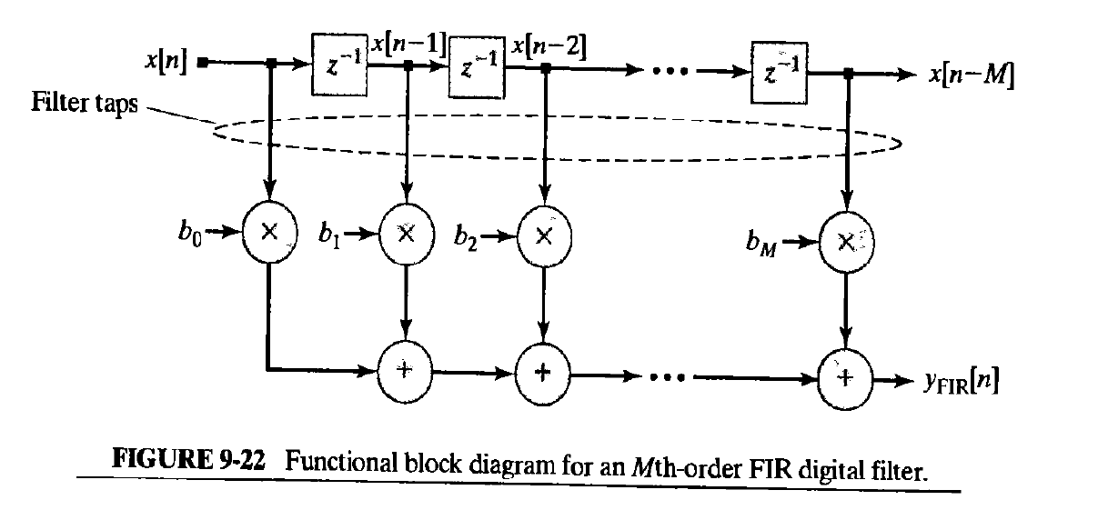

Slide 12
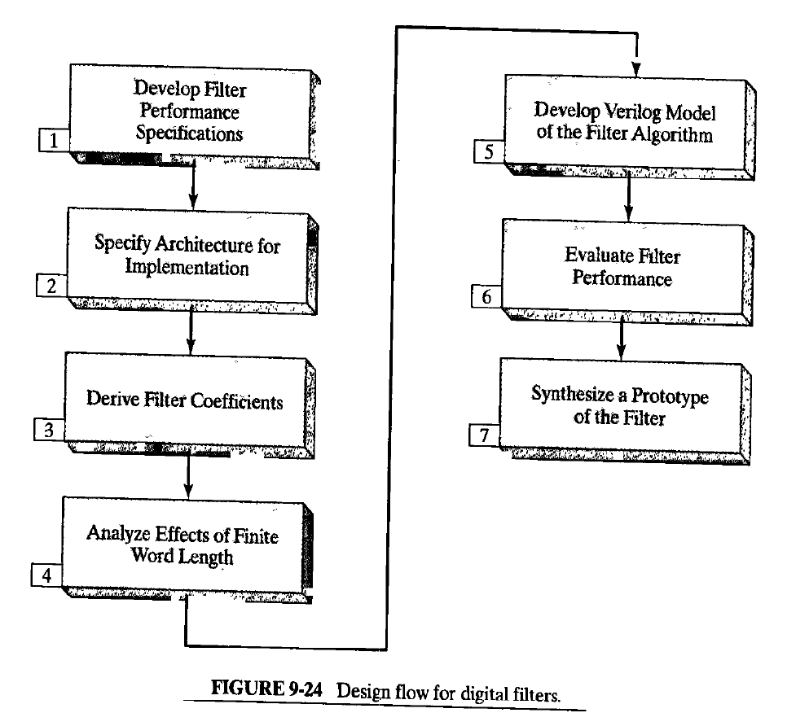
Filter Design Process

Slide 13
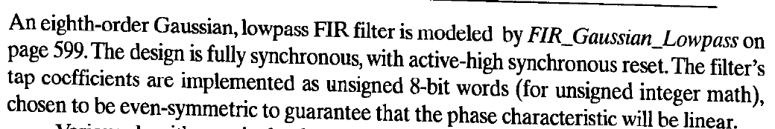
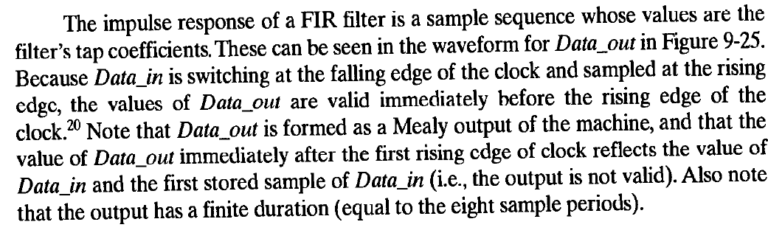
8th Order FIR Filter

Slide 14
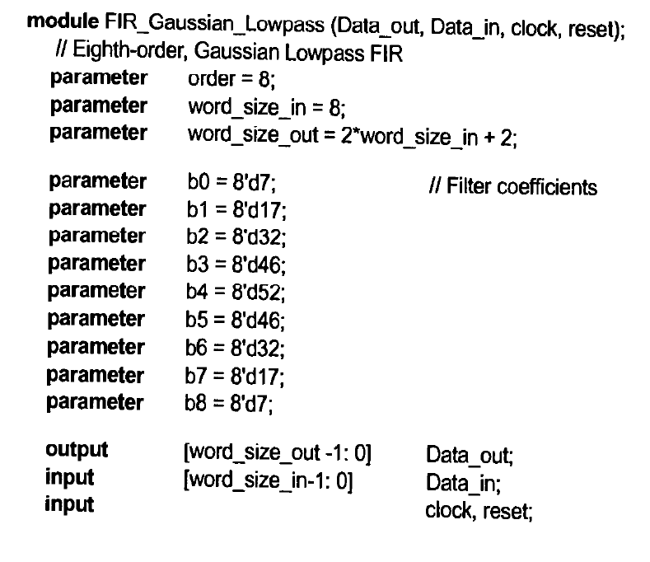
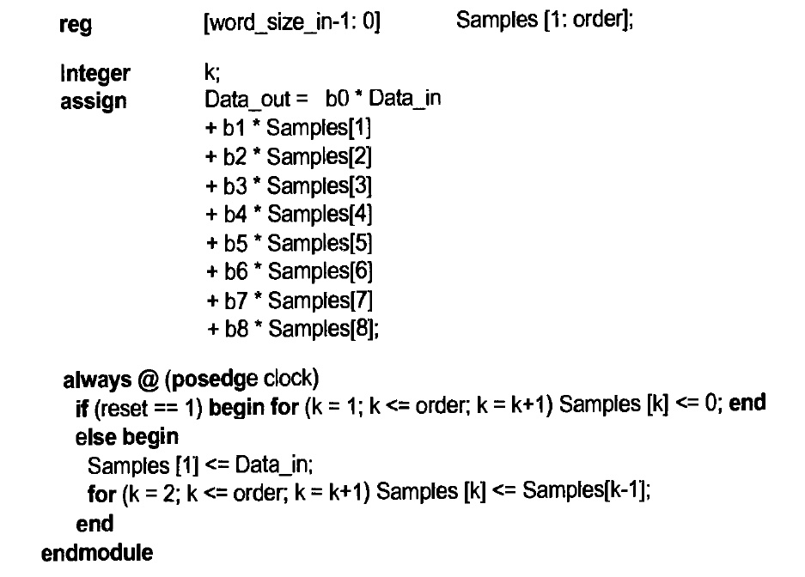

Slide 15
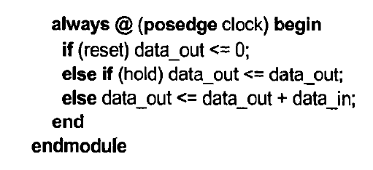
Building Blocks for Signal Processors
Accumulators

Slide 16
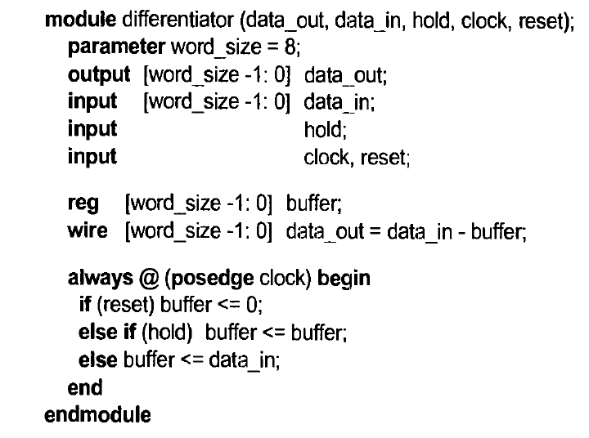
Differentiator

Slide 17
Decimation and Interpolation Filters

